Slide 1
Banking Management System
Built Using C Programming and Linked List
Presented by
Reetesh Mahapatra

Slide 2
OBJECTIVE
Perform operations like
Create Account
Print Passbook
Balance Enquiry
Withdrawal Balance
Deposit Balance
Balance Transfer
Delete Account
View & Update Account Holder Details
Loan

Slide 3
TECHNOLOGY
Programming Language: C
Concepts Used: Structures, Linked List, Functions
Compiler: VS CODE

Slide 4
STRUCTURE USED
/* Customer Details Structure */
typedef struct customer
{
char name[100];
char address[500];
unsigned long long int Aadhaar_id;
char pan_id[16];
unsigned long long int mob_no;
short int age;
} customer;

Slide 5
STRUCTURE USED
/* Nominee Details Structure */
typedef struct nominee
{
customer cust;
char relation[20];
} nominee;

Slide 6
STRUCTURE USED
/* Banking Details Structure */
typedef struct Banking
{
unsigned long long int sav_ac_no;
unsigned long long int cur_ac_no;
char IFSC_code[20];
long int balance;
} Banking;

Slide 7
STRUCTURE USED
/* Main Structure*/
typedef struct accountdetails
{
// int choice;
customer cust;
nominee nom;
Banking bank;
struct accountdetails *next;
} accountdetails;

Slide 8
Global Veriable
/*Global veriable*/
unsigned long long int MIN_SAVINGS_ACC = 1200010100100;
unsigned long long int MAX_SAVINGS_ACC = 1200010100599;
unsigned long long int MIN_CURRENT_ACC = 1200010100600;
unsigned long long int MAX_CURRENT_ACC =1200010101200;
char IFSC_code[20]= "BANDW0000001";

Slide 9
Global pointer
/*Global Pointer*/
accountdetails *new,*temp,*head=NULL,*dest,*previous=NULL;

Slide 10
Function declaration
/*Function declaration*/
void Bank();
void CreateAccount();
void printPassbook();
void balanceTransfer();
void viewAndUpdateAccountHolder();
void WithdrawalBalance();
void DepositBalance();
void updateBankDetails(accountdetails *new);
void Loan();
void displayAllaccount(accountdetails *head);
void deleteAccount();
void BalanceEnquiry();

Slide 11
FEATURES
Add new bank account
Display all account details
Search account by bank account number
Update existing account holder details
Delete account holder details

Slide 12
PROGRAM FLOW
Start menu
Branch Manager → Display All account
→ Exit
Frontline Staff → Create Account
→ Print Passbook
→ Withdrawal Balance
→ Deposit Balance
→ Balance Transfer
→ Delete Account
→ View & Update Account Holder Details
→ Loan

Slide 13
CODE SNIPPET
void CreateAccount()
{
new=(accountdetails *)malloc(sizeof(accountdetails));
…
…
}

Slide 14
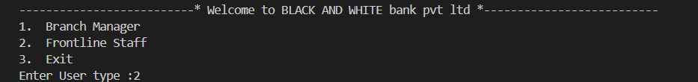
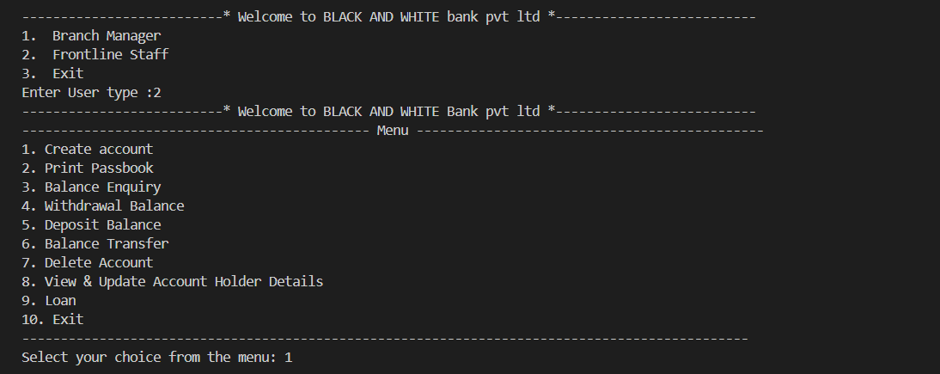
OUTPUT SCREENSHOT
Start Menu

Slide 15
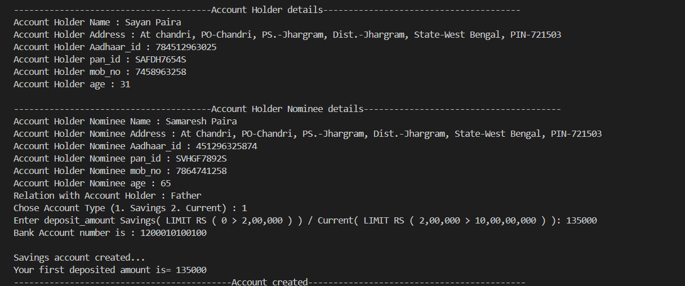
OUTPUT SCREENSHOT
Create Account

Slide 16
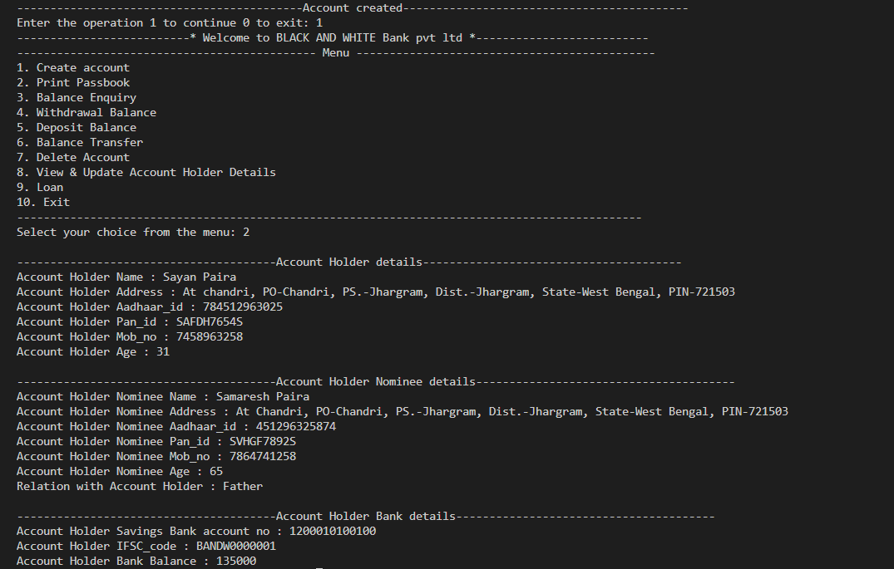
OUTPUT SCREENSHOT
Print Passbook

Slide 17
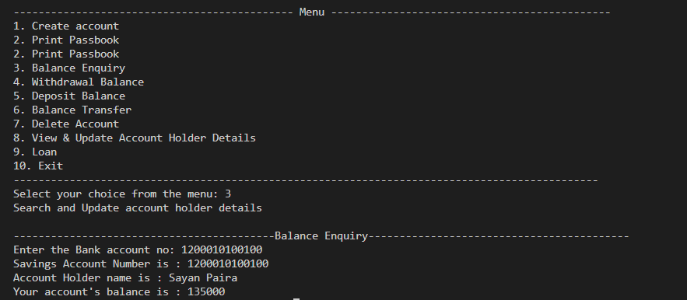
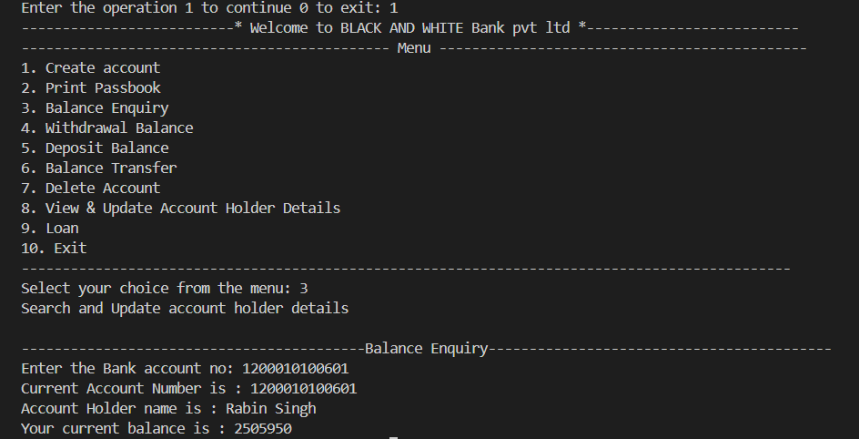
OUTPUT SCREENSHOT
Balance Enquiry

Slide 18
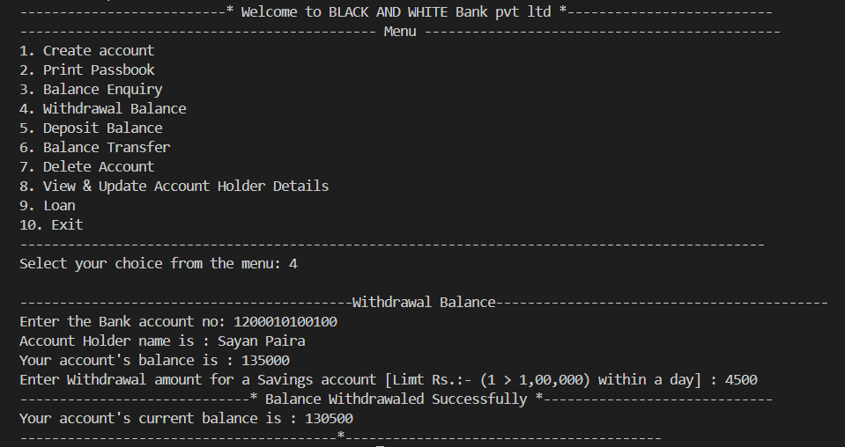
OUTPUT SCREENSHOT
Withdrawal Balance

Slide 19
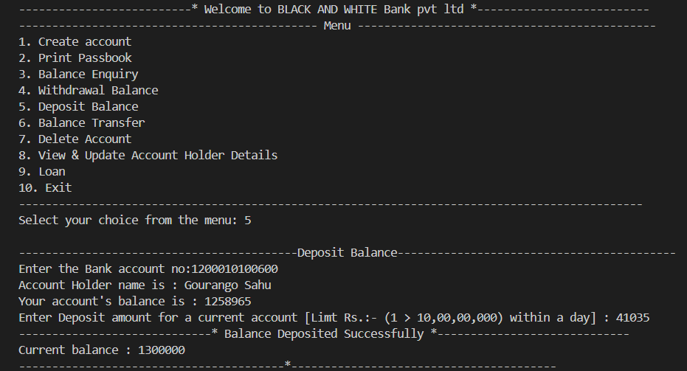
OUTPUT SCREENSHOT
Deposit Balance

Slide 20
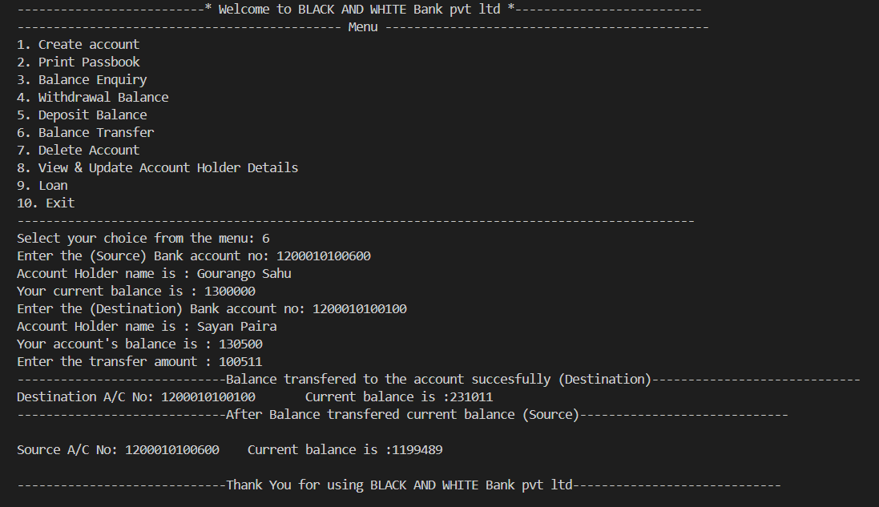
OUTPUT SCREENSHOT
Balance Transfer

Slide 21
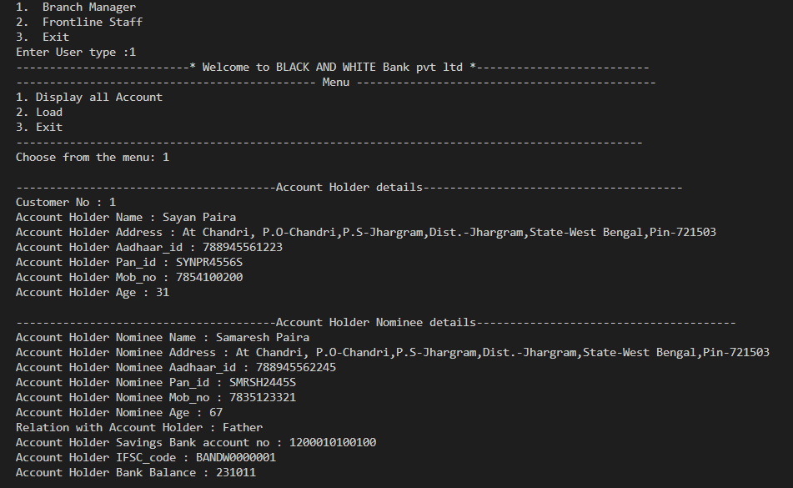
OUTPUT SCREENSHOT
Branch Manager Display All Account

Slide 22
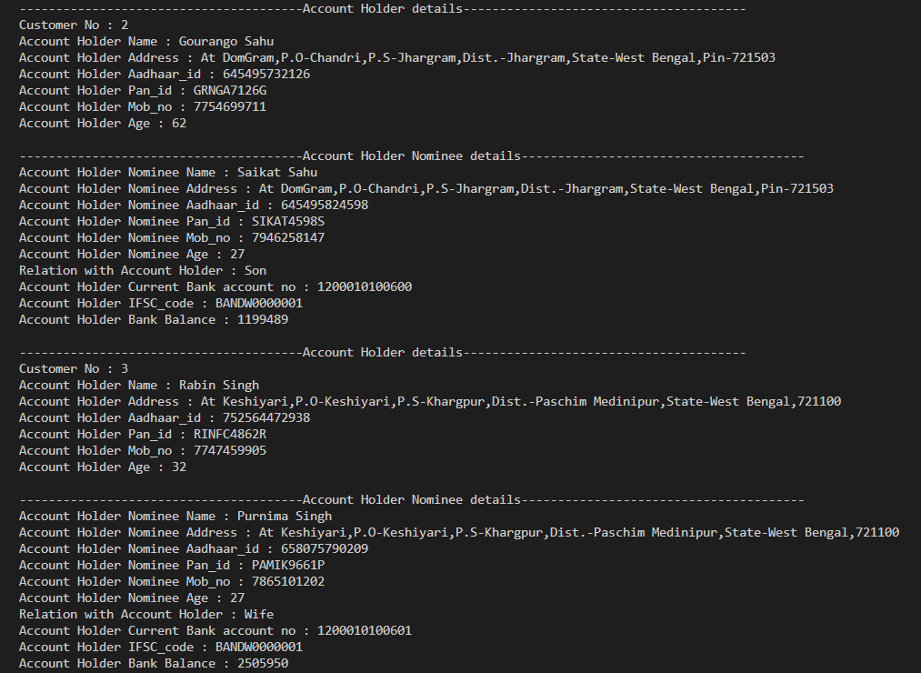
OUTPUT SCREENSHOT
Branch Manager Display All Account Continue

Slide 23
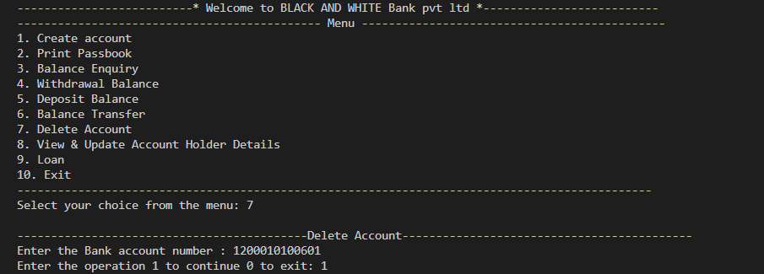
OUTPUT SCREENSHOT
Delete Account

Slide 24
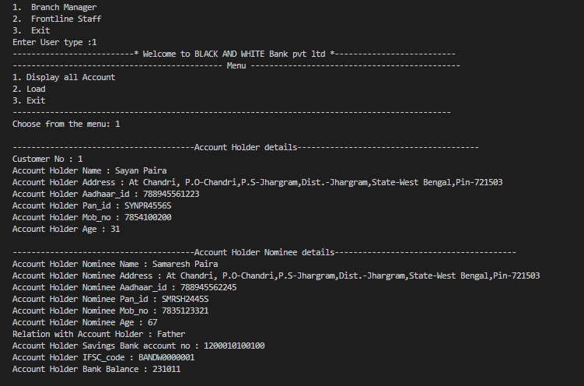
OUTPUT SCREENSHOT
Branch Manager Display All Account

Slide 25
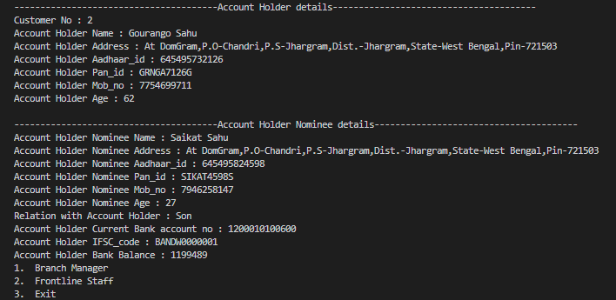
OUTPUT SCREENSHOT
Branch Manager Display All Account Continue

Slide 26
FUTURE ENHANCEMENTS
Log in
Interest
Fixed deposit
Locker
Transaction History
Save & Load file

Slide 27
CONCLUSION
This project helped me improve my C programming skills, especially in using linked lists . It also taught me how to design and structure a real-life mini software system."

Slide 28
THANK YOU

